Slide 1
Corrective Action System V 2.0 – For Internal Use

Slide 2
CAR System:
Corrective Action Request
System intended to improve existing quality system.
Easy the browsing process and completion of actions.
All information is automatically stored in to Halliburton system.
Global Champions:
Hai Nguyen
Oscar Recio

Slide 3
Important Notes
Vendor will be capable to answer corrective action without a Halliburton representative notification need.
Corrective action serialization will be automated.
Evidence submission will be reliable through the system without the need to use email storage capacity.
Vendors or issued responsible will be notified in automatic fashion through email correspondence.
Search actions will be boosted by the system be capable to frame the research conditions.

Slide 4
https://supplychain.corp.halliburton.com/CAR/

Slide 5
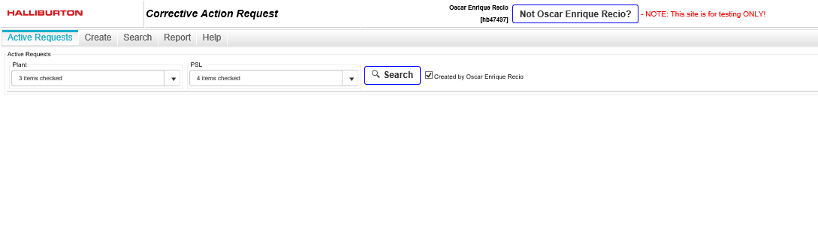
Click on Request Forms

Slide 6
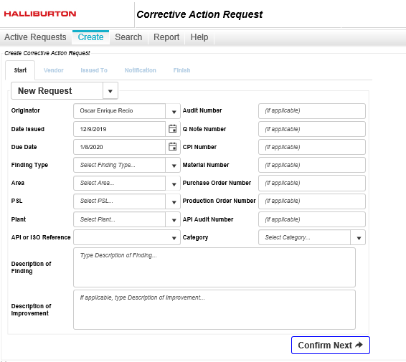
Select ‘Create’ tab to start corrective action.

Slide 7
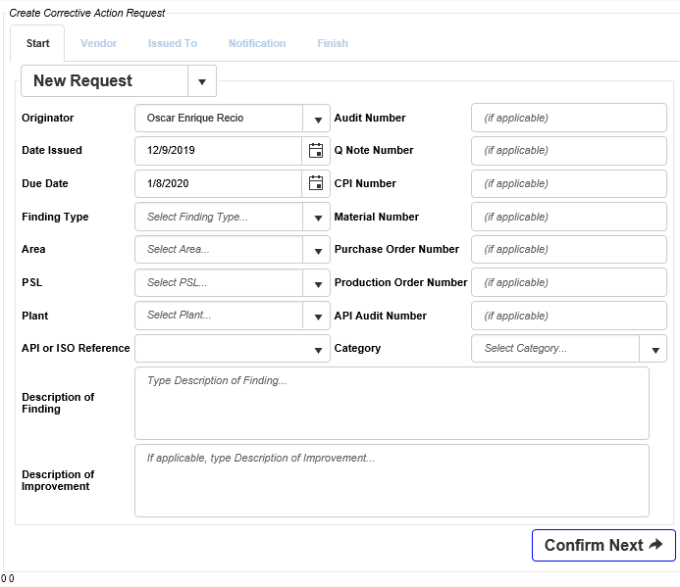
START - tab
Select and complete every field:
Originator name.
Date issued.
Due date: Unless otherwise is required, vendors will have 30 days to respond.
Finding type:
No-Conformance
Observation/Concern
Area:
Customer.
Internal.
Preventive.
Regulatory.
Supplier.
TapRoot®
PSL (Product Service Line), select as needed.
Plant, select the plant number where this corrective action was created.
API or ISO Reference: select standard associated with this finding.

Slide 8
START - tab
Select and complete every field:
Audit number.
Q-note number.
CPI or Event number.
Purchase Order Number.
Production Order Number.
API audit number.
Category.

Slide 9
START - tab
Complete description finding or description for improvement.

Slide 10
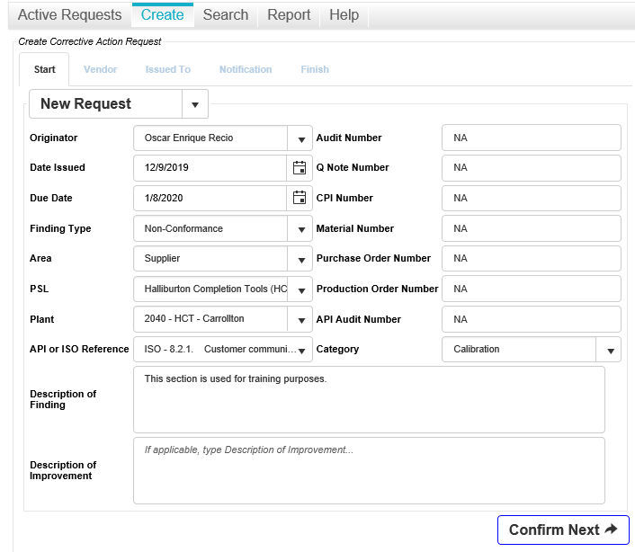
START - tab
Confirm section

Slide 11
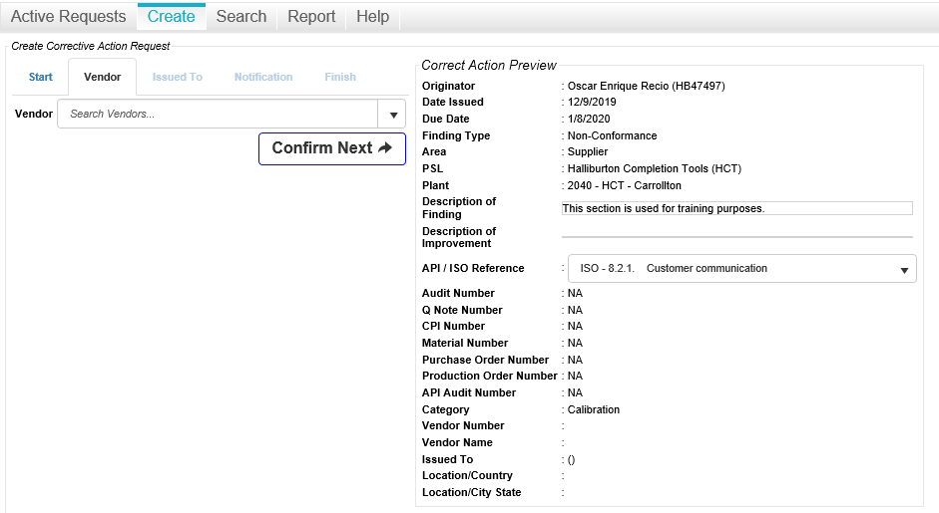
VENDOR - tab

Slide 12
VENDOR - tab
Among Halliburton known vendors, select the one responsible.
Confirm section

Slide 13
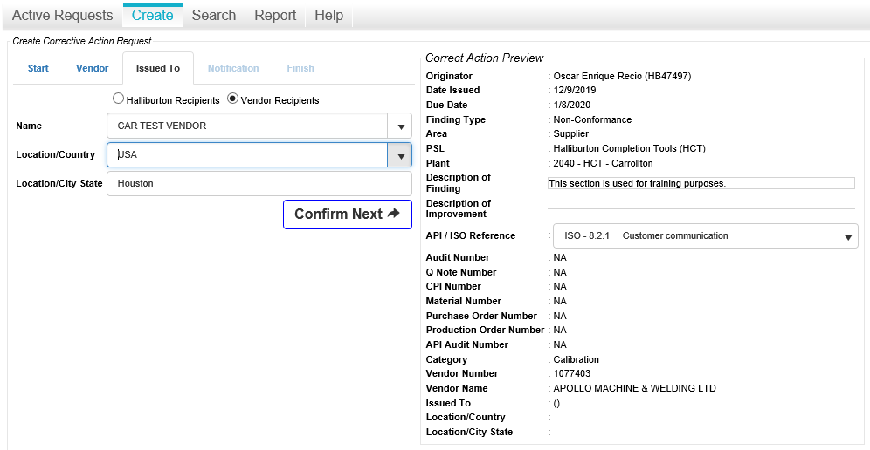
ISSUED TO - tab
Pressing drop down menu a contact name list will be displayed, select and confirm, location country and city

Slide 14
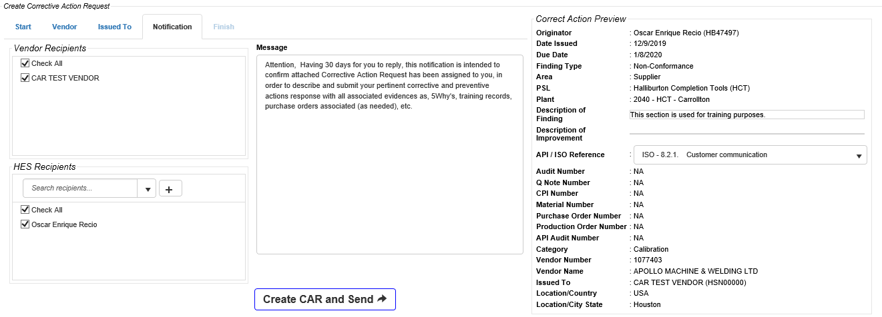
NOTIFICATION - tab
For the notification step, standardized notification will be prompted to be used, or else edition of this notification is allowed to be done.
Confirmation of email addresses is allowed to be done before submission.
On your left hand, preview format is allowed for review process.

Slide 15
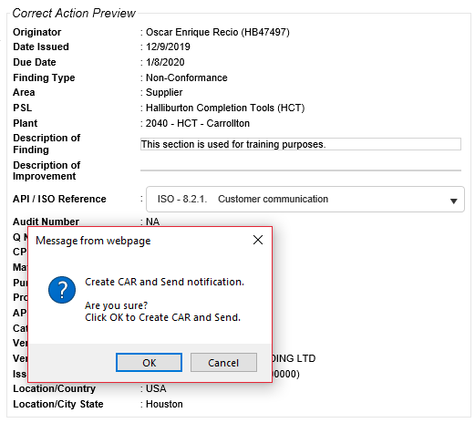
NOTIFICATION - tab
Confirmation before submission required before CAR creation.

Slide 16
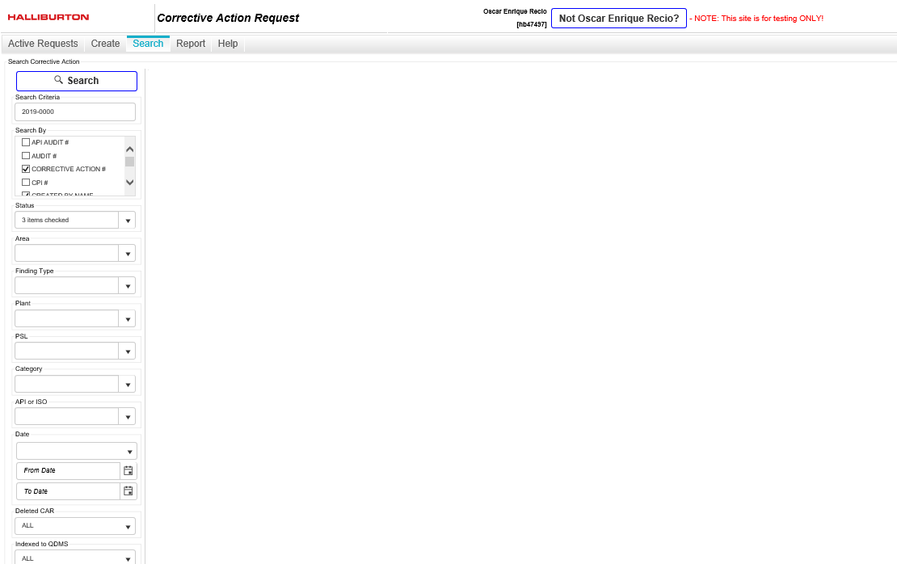
SEARCH - tab
Confirm section
Confirm section
Confirm section
Confirm section
Search section will allow you to look up for RFAs previously submitted in order to review.
Confirm section
Confirm section
Confirm section
Confirm section
Confirm section
Confirm section

Slide 17
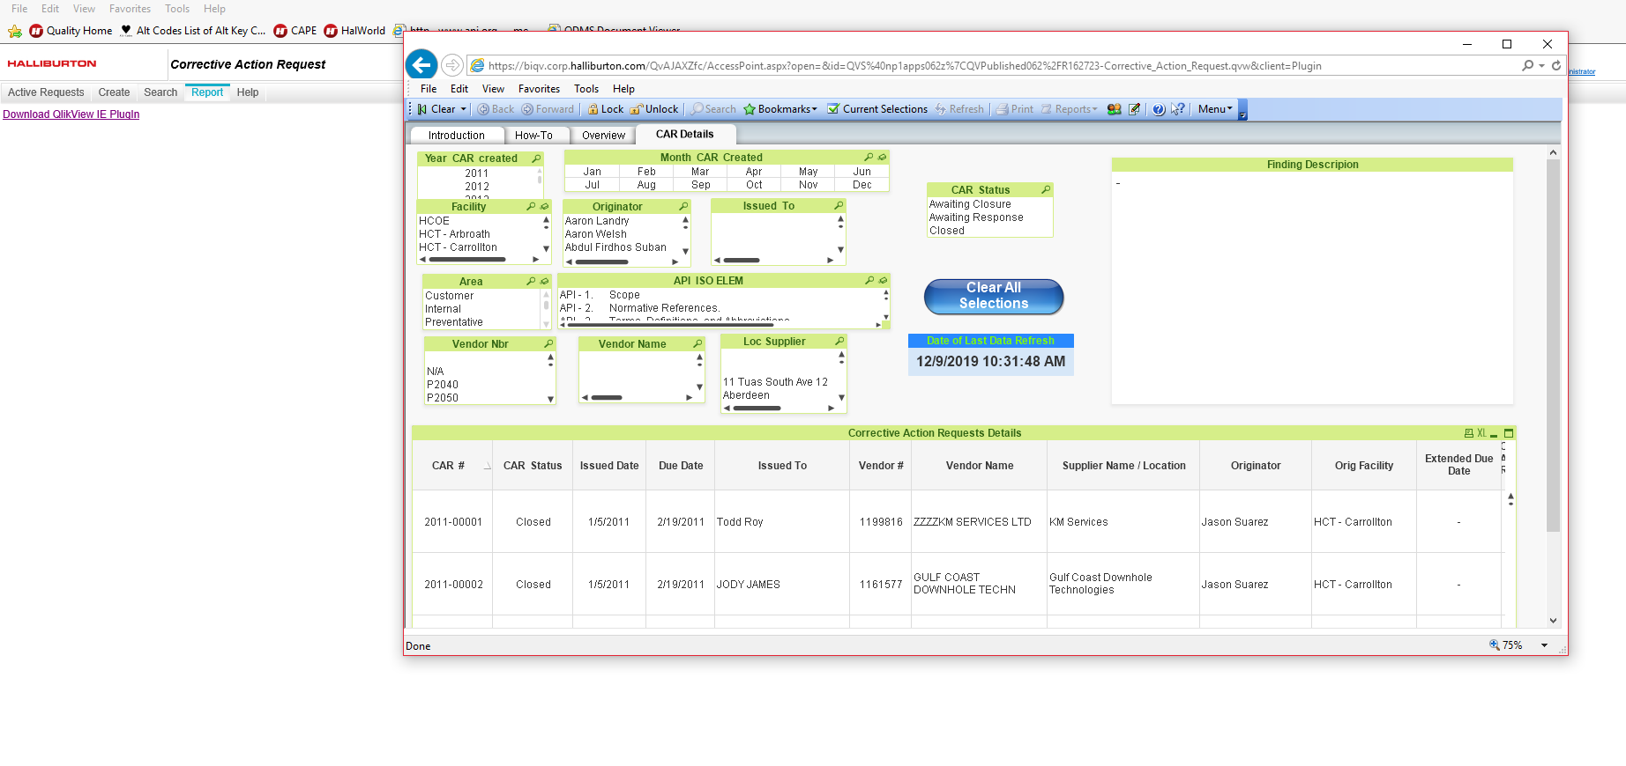
REPORT - tab
Report tab, will open existing CAR QuickView report.

Slide 18

Wait! There’s more!

Slide 19
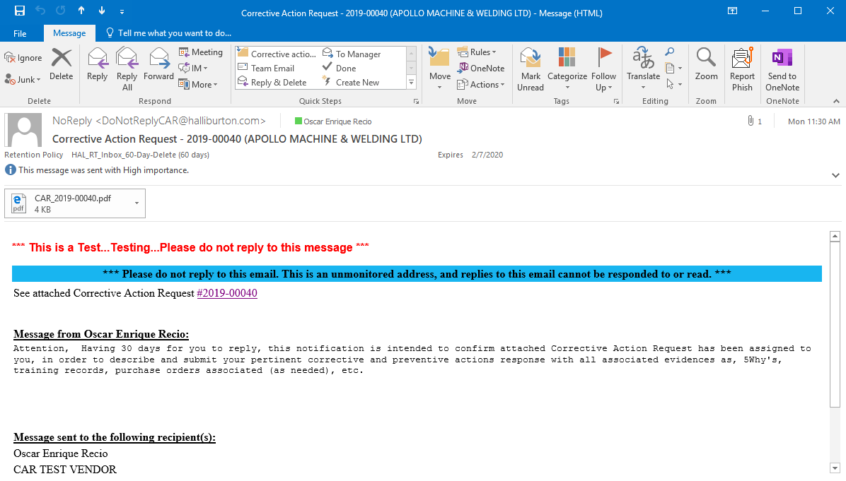
Notification email
Corrective action requestor, will receive an email confirming the CAR number and the corrective action file (*.PDF format).
Access the link.

Slide 20
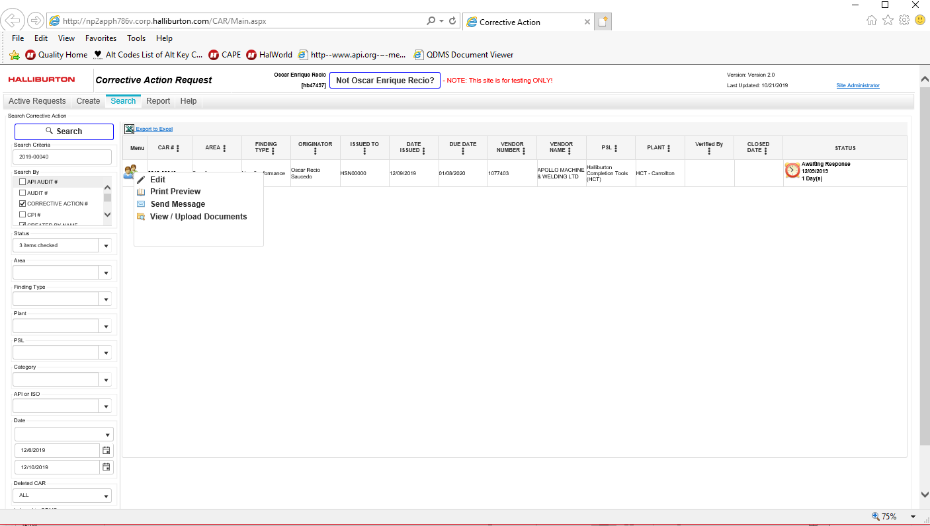
CAR access link
After access CAR number link, new internet page will prompt and by clicking over the persons drawing, four more option will display:
Edit.
Print Preview
Send Message
View/Upload documents (evidence).
A clocking watch will be showing the time since the CAR was issued and the counting days.

Slide 21
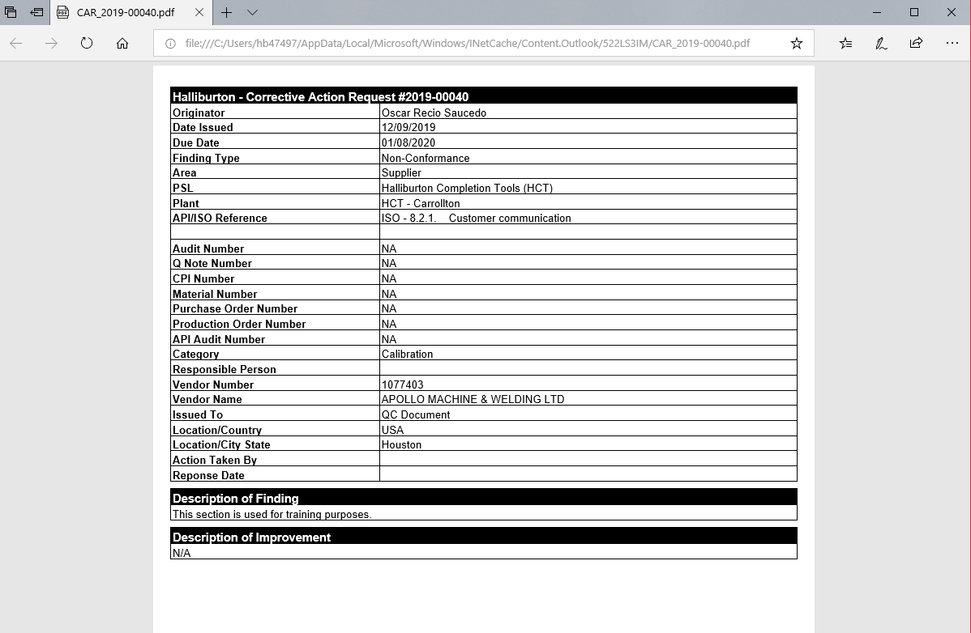
CAR print preview
File will consist on three pages:
For the corrective action heather.

Slide 22
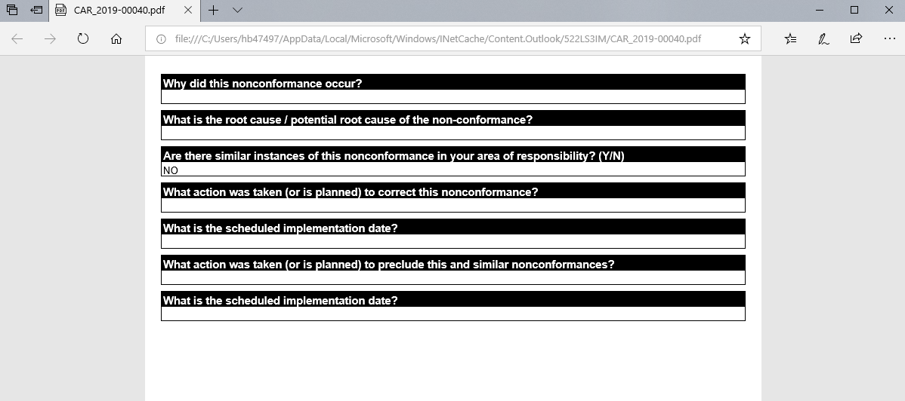
CAR print preview
File will consist on three pages:
Investigation questions answers.
NOTE: at the time of this email answers will be empty.

Slide 23
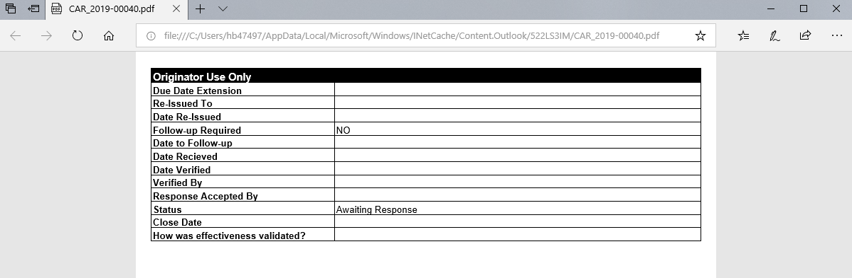
CAR print preview
File will consist on three pages:
Last page will be used for closeness confirmation.

Slide 24
Questions?

Slide 25
For closeness purposes:
Responsible needs to confirm closure actions effectiveness.
Audits may be requried as a follow up.

